Slide 1
Deploying Open5g applications with continuous integration
PROJECT GUIDE: GROUP MEMBERS:
Debobroto Das Robin, Akhil Reddy Nalla (811172556)
Divya Sri Karingula(811172271)
Professor Ishita Patel (811164714) Khushbu Brahmbhatt (811127760)

Slide 2
Milestone 1 Recap
In previous we have discussed how the developer will create a branch to push their code in our repository.
Set up Ec2 instances
Set up Ubuntu machines
Set up Docker Engine
Set Jenkins instance
Creating a docker script and downloading the components from GitHub.

Slide 3
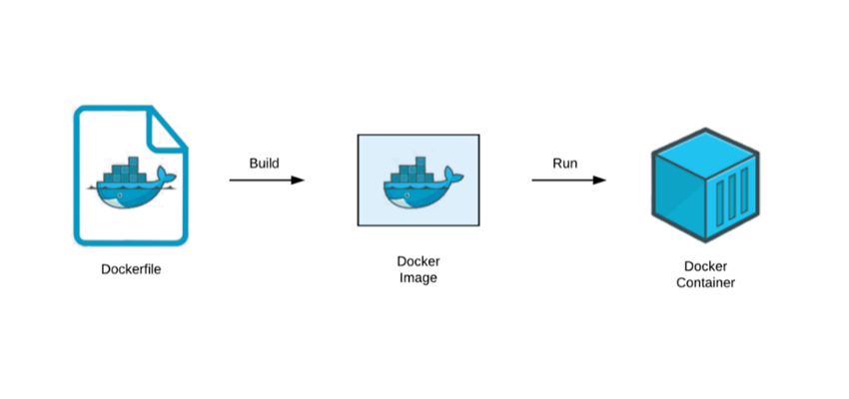
Milestone 2 Recap
In this project we will clone the code and write Docker files, build Docker images and we are going to run in docker containers.
We are going to use Jenkins pipeline to do continues integration/ continues development (CI/CD) of open 5g applications.

Slide 4
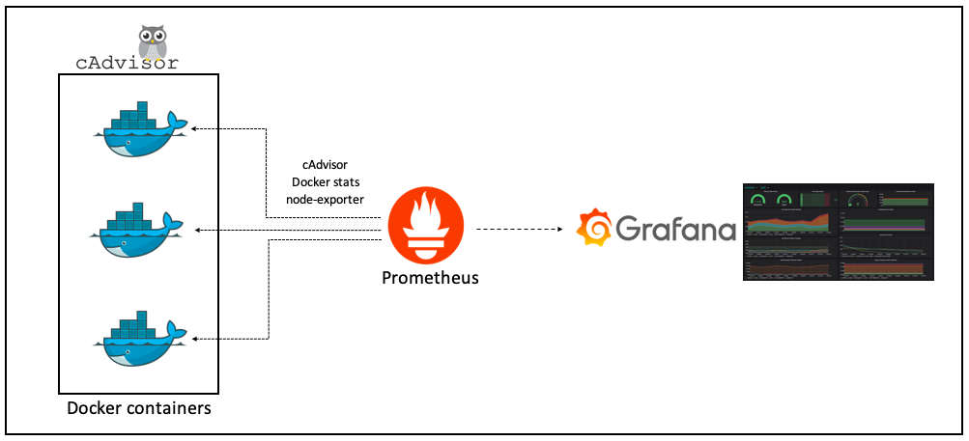
Milestone 3 Overview
In this Milestone we will be Automating the IP configuration for Open5gs components
Then using the Cadvisor for container monitoring
Prometheus collects data and metrics from different services and stores them according to a unique identifier

Slide 5
AWS Service
AWS Management console will provide multiple ways for navigating to individual service console
Amazon Elastic Compute Cloud (Amazon EC2) provides scalable computing capacity in the Amazon Web Services (AWS) Cloud.
Block storage It is a technology which stores the data and divides the data into blocks for fast access.
Security Policy for inbound value of ports access
IAM It is a web service which gives the secure access to aws resources

Slide 6
Tools used
GitHub Code Repo
AWS Service
Docker Engine
Docker Hub Registry
Jenkins
Cadvisor
Grafana
Prometheus

Slide 7
Prometheus
Open-source tool that provides monitoring and alerting for cloud-native systems
Time-series data, including a timestamp for each entry.
Key features –
Multidimensional Data Model, Pushing Time-series Data, Visualization

Slide 8
Grafana
A visualizing tool with a dashboard that provides a lot of options with graphs.
open-source tool to view the metrics, do the queries, and get alerts of logs being generated.
Charts and graphs are generated from data sources and available through a web browser.

Slide 9
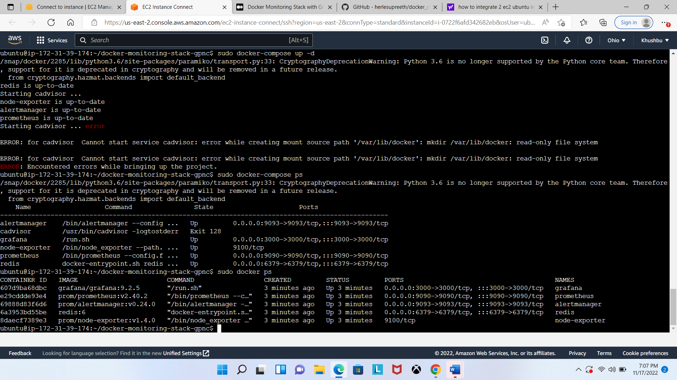
AWS Instance:

Slide 10
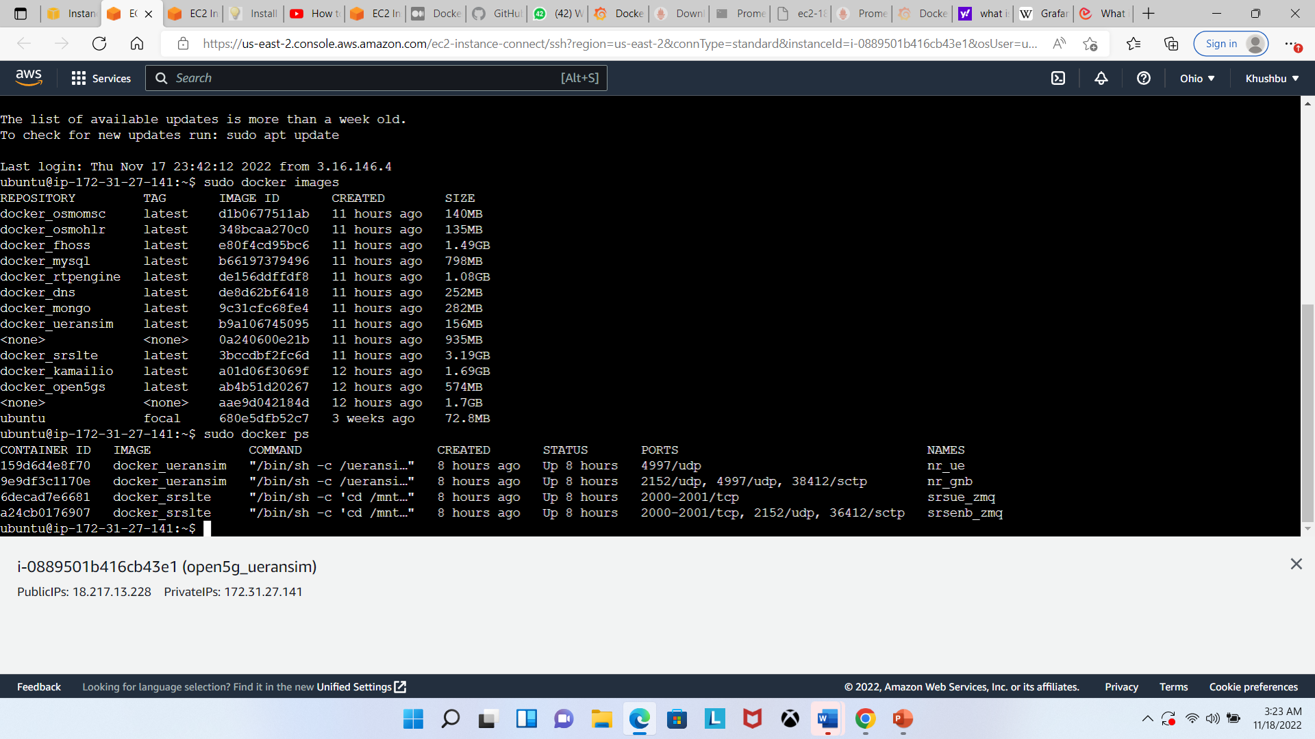
AWS Instance:

Slide 11
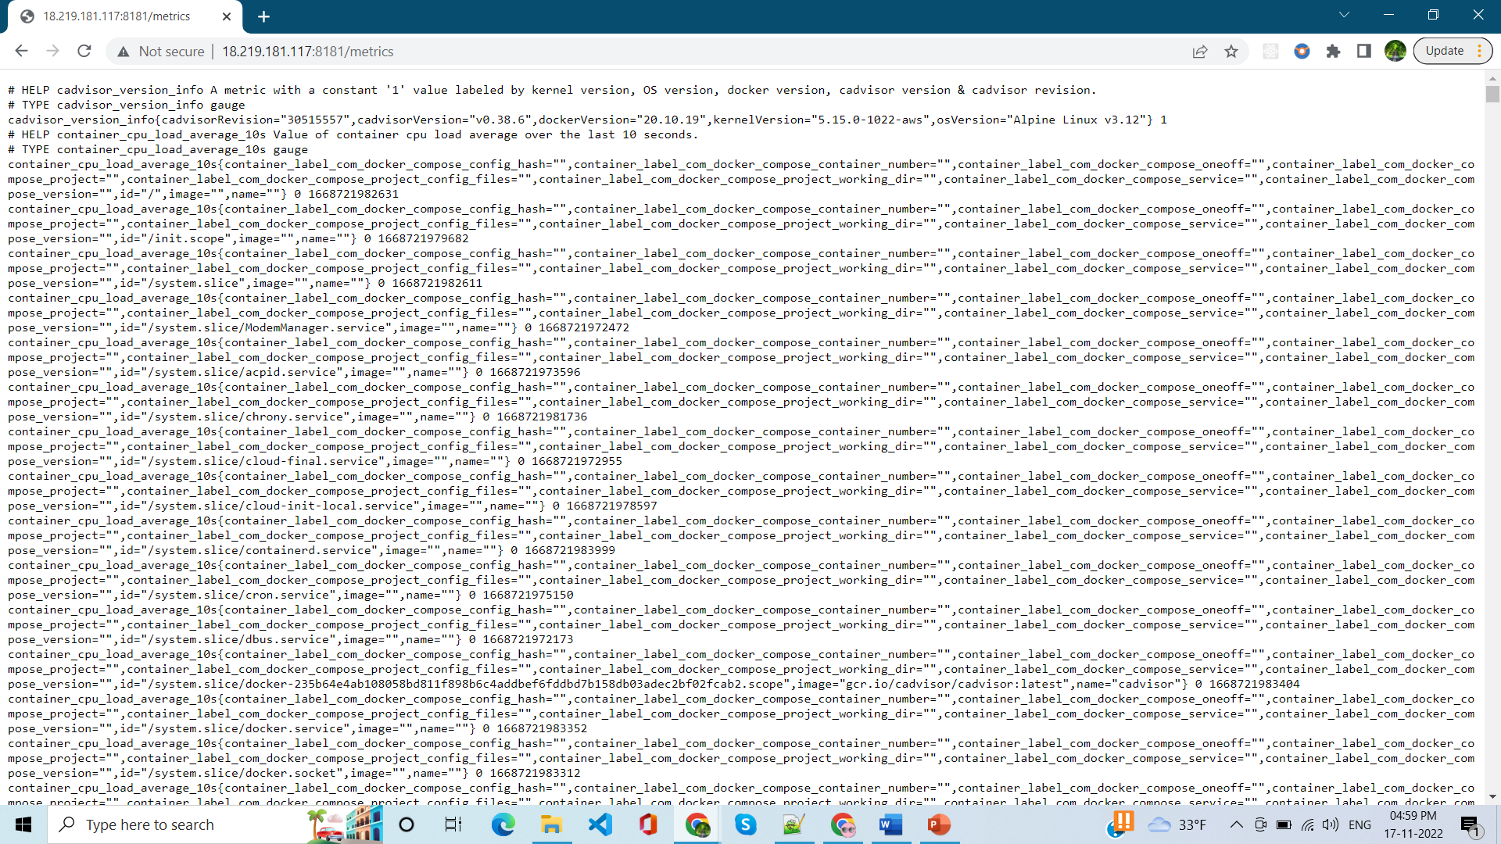
Cadvisor

Slide 12
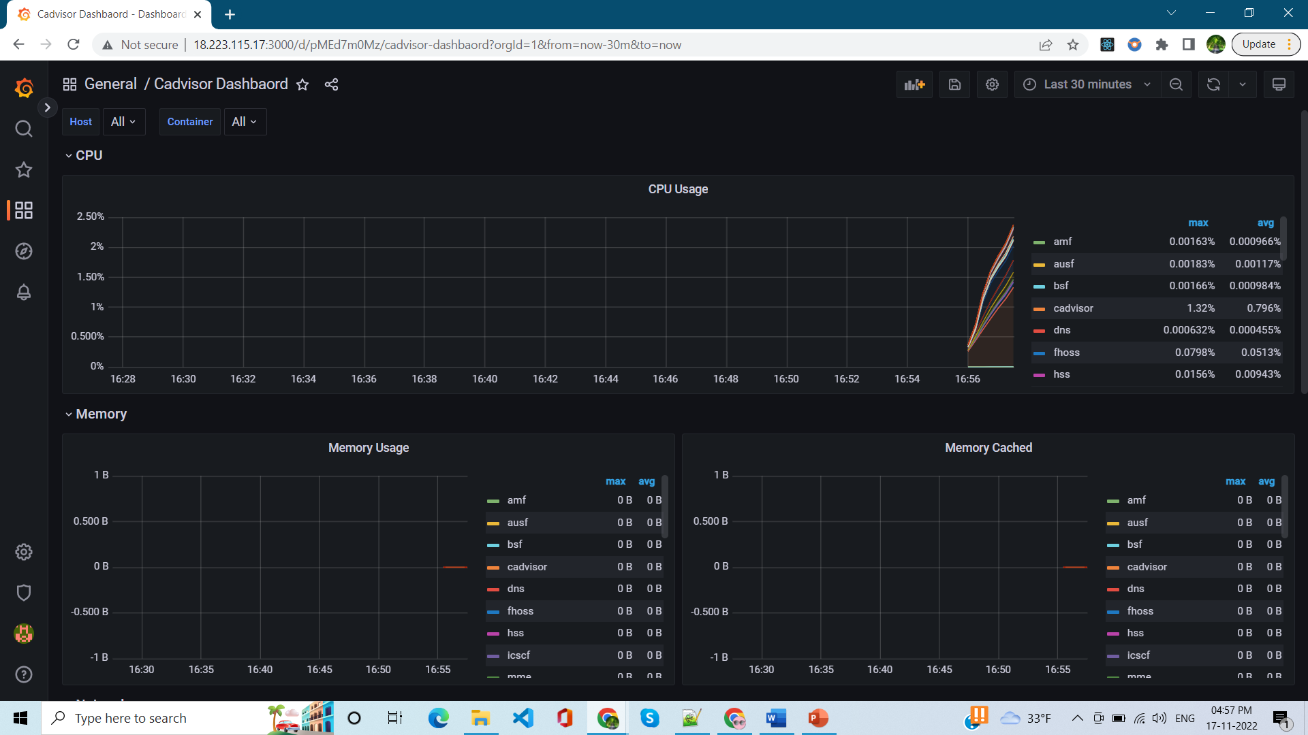
Grafana

Slide 13
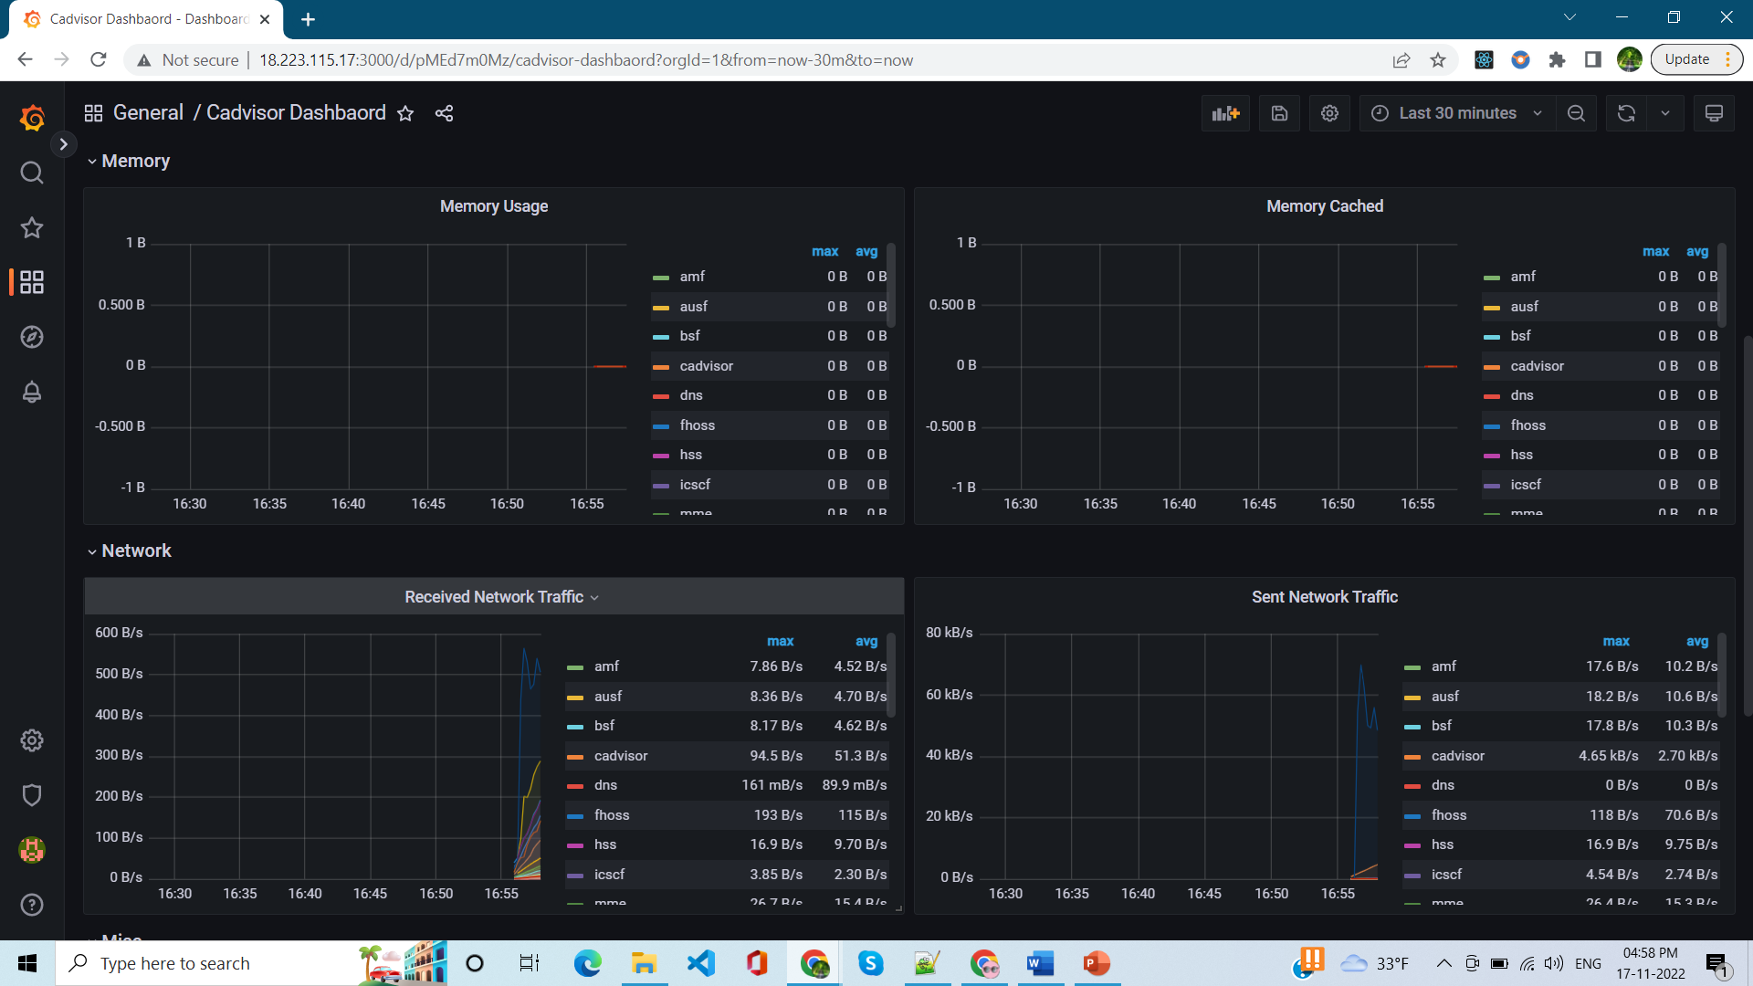
Grafana:

Slide 14
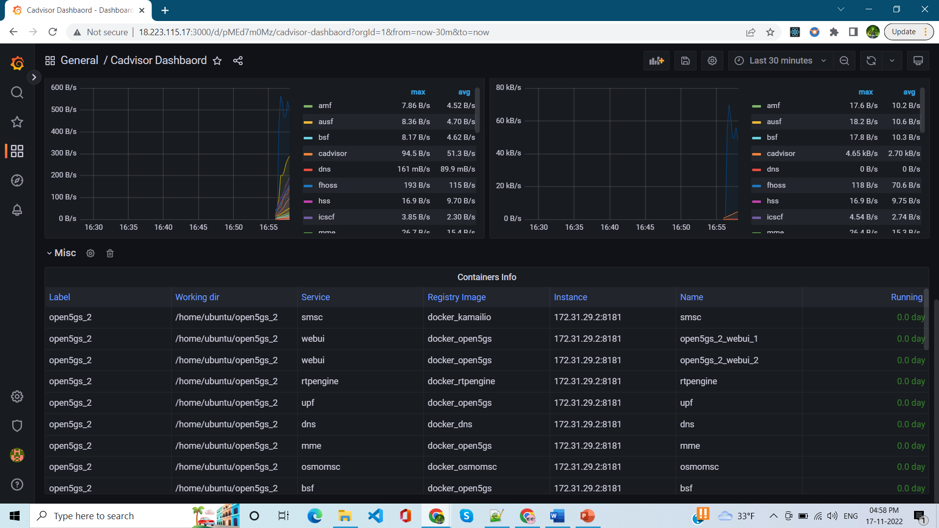
Grafana:

Slide 15
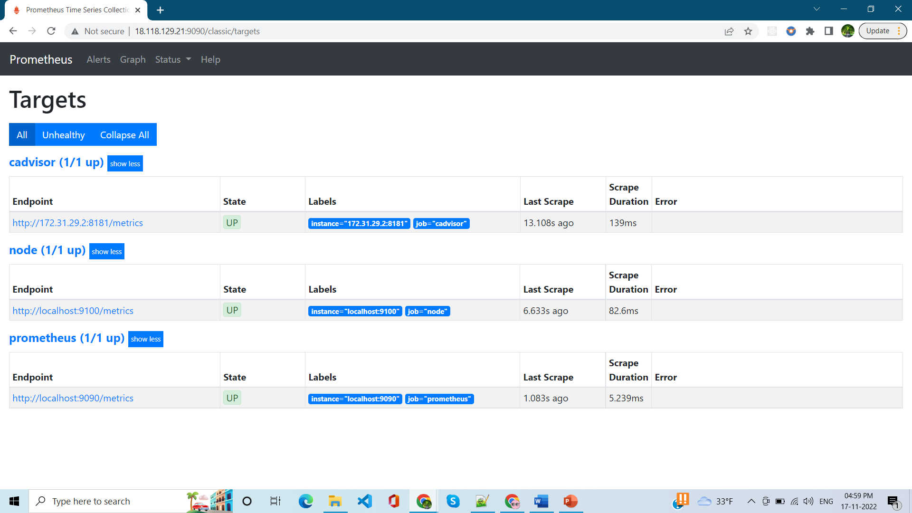
Prometheus

Slide 16
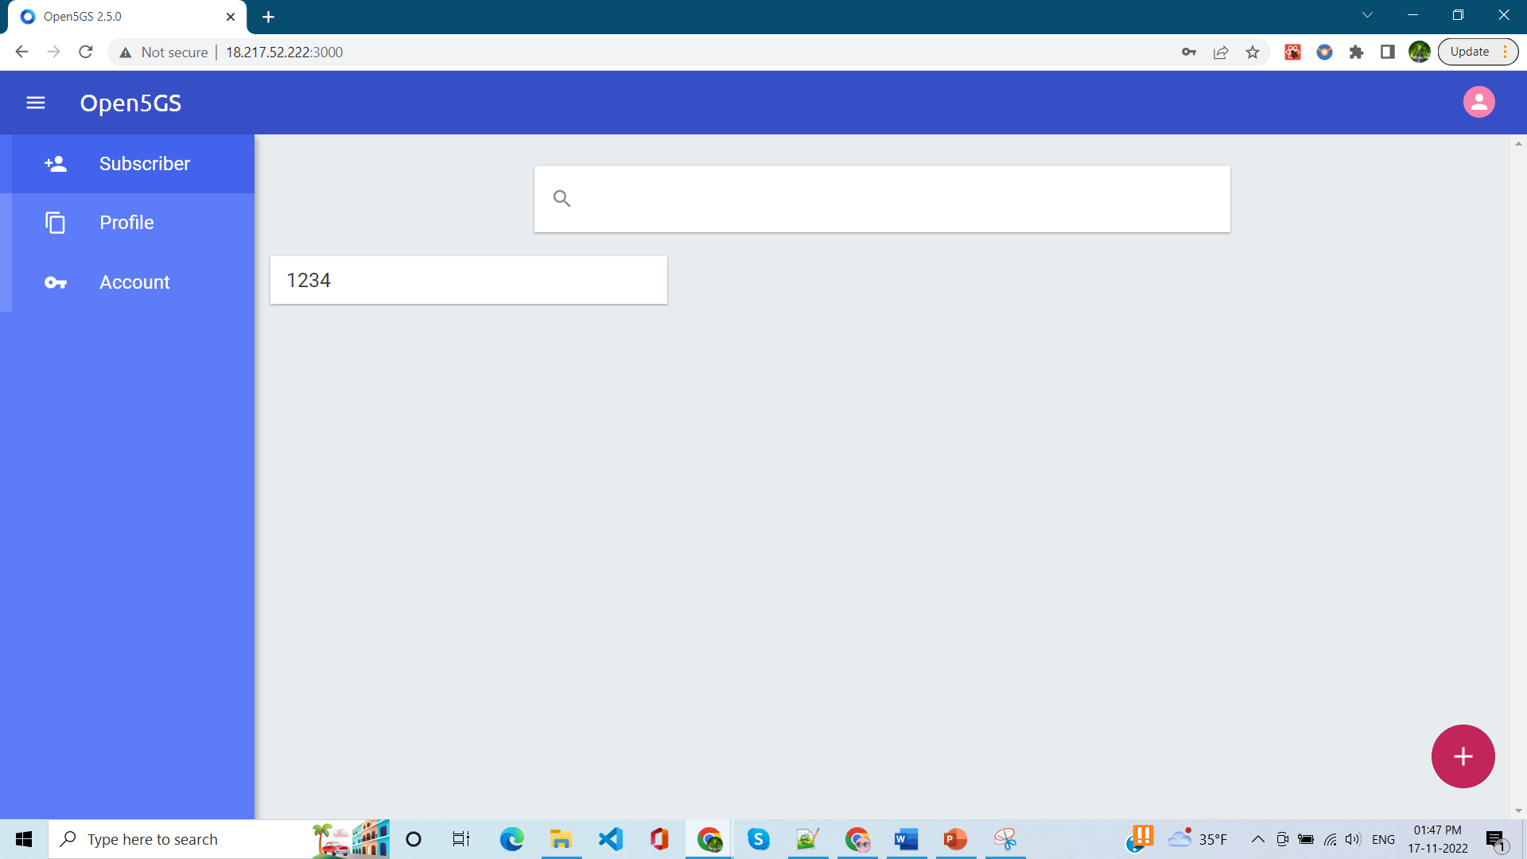
Open5g Application

Slide 17
Implementation
Demo

Slide 18
References
https://github.com/open5gs/open5gs
Nikolaos Apostolakis, Marco Gramaglia, and Pablo Serrano - Design and Validation of an Open Source Cloud Native Mobile Network
https://open5gs.org/open5gs
https://medium.com/rahasak/5g-core-network-setup-with-open5gs-and-ueransim-cd0e77025fd7
Docker Hub Account: https://hub.docker.com/u/akhilreddy62
GitHub Repo link: https://github.com/AkhilReddy62/open5gs_2

Slide 19
Thank You.
www.kent.edu

